Slide 1
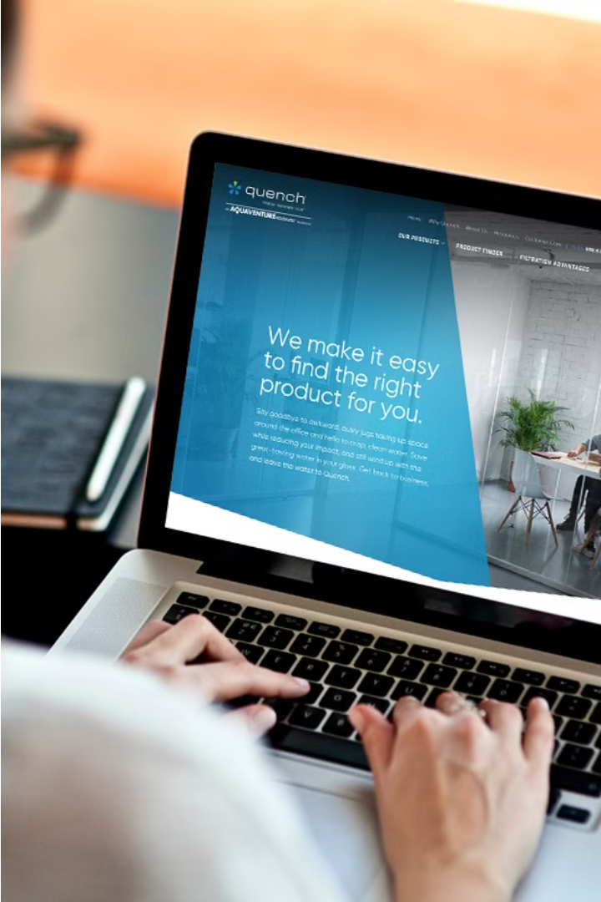
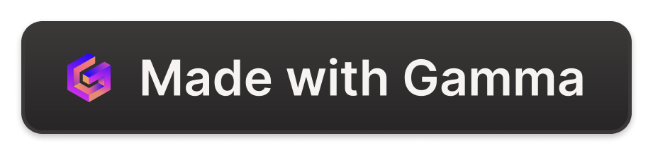
Web Designer
Adarsh Kumar is a skilled web designer with a passion for crafting visually stunning and user-friendly websites. His expertise in responsive design and modern web technologies helps him create experiences that captivate audiences and drive business success.

Slide 2
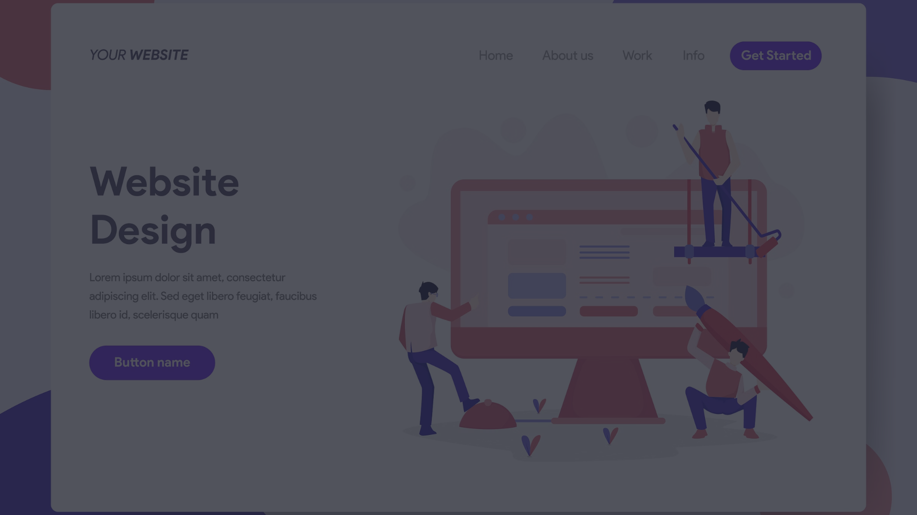
What is web designing
Web design is the process of creating and structuring the visual layout, content, and functionality of a website. It involves designing the overall aesthetic, user experience, and technical aspects of a website to meet the needs of the target audience.
Effective web design combines elements like typography, color schemes, imagery, and layout to create an engaging and intuitive online presence for a business or organization.

Slide 3

Old trends in web design
Cluttered, busy designs with too many elements on the page
Use of outdated technologies like Flash and tables for layout
Low-quality, pixelated images and graphics

Slide 4
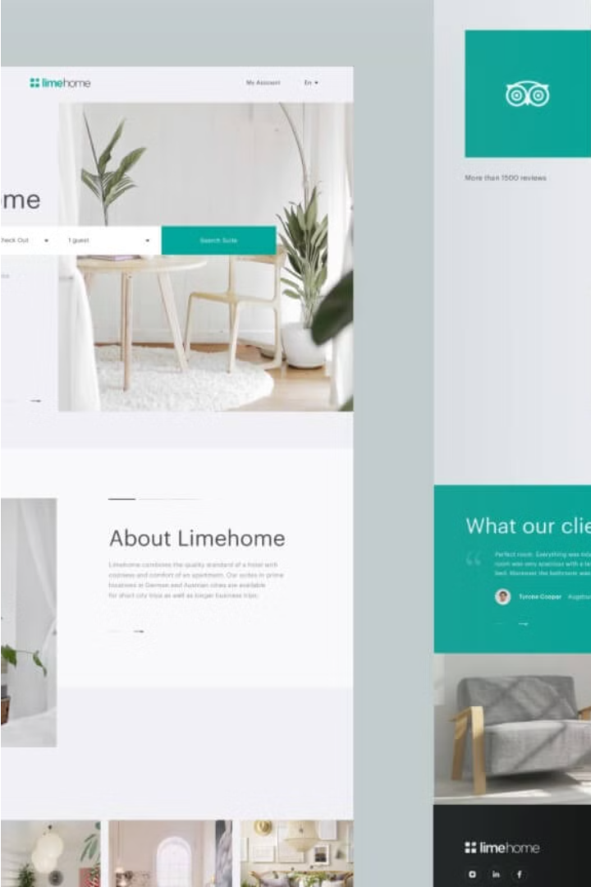
New Trends in Web Design
In recent years, web design has evolved with a focus on minimalism, mobile-first experiences, and interactive animations. Designers are embracing bold typography, vivid color palettes, and seamless scrolling to create engaging and user-friendly websites.
Another emerging trend is the increased use of AI-powered features, such as chatbots and personalized recommendations, to enhance the user experience. Websites are also becoming more accessible, with improved support for accessibility standards and assistive technologies.

Slide 5
Career orientation of Web Design
1
Frontend Developer
2
UX Designer
Create visually appealing and responsive user interfaces using HTML, CSS, and JavaScript.
Conduct user research, design wireframes, and optimize the overall user experience.
3
Web Content Manager
4
Digital Marketing Specialist
Manage and curate website content, ensuring it's engaging, informative, and aligned with brand guidelines.
Leverage web design skills to create effective online marketing campaigns and drive digital growth.

Slide 6

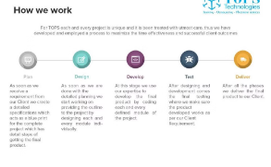
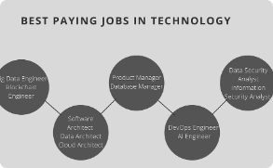
Learning at TOPS Technologies
State-of-the-Art Facilities
Expert Instructors
Hands-on Projects
Career Guidance
Benefit from TOPS Technologies' career services, including resume building, interview preparation, and internship opportunities.
TOPS Technologies provides modern, well-equipped classrooms and labs to deliver an immersive learning experience for web design students.
Learn from seasoned web design professionals who bring real-world expertise and a passion for teaching the latest techniques.
Engage in practical, project-based learning to develop a strong portfolio and the skills needed to excel in the web design industry.

Slide 7
About the Course
Comprehensive Curriculum
Hands-On Projects
Expert Instruction
Interactive Learning
The web design course covers a wide range of topics, from HTML and CSS to responsive design and JavaScript. You'll gain a strong foundation in the essential skills needed to create modern, visually appealing websites.
Through practical, project-based learning, you'll have the opportunity to apply your knowledge and build a portfolio of impressive websites. These projects will help you develop real-world skills and prepare you for a career in web design.
The course is taught by experienced web design professionals who will share their industry insights and guide you through the latest web design trends and best practices.
The course utilizes a variety of teaching methods, including interactive lectures, workshops, and one-on-one feedback, to ensure you fully understand and retain the material.

Slide 8
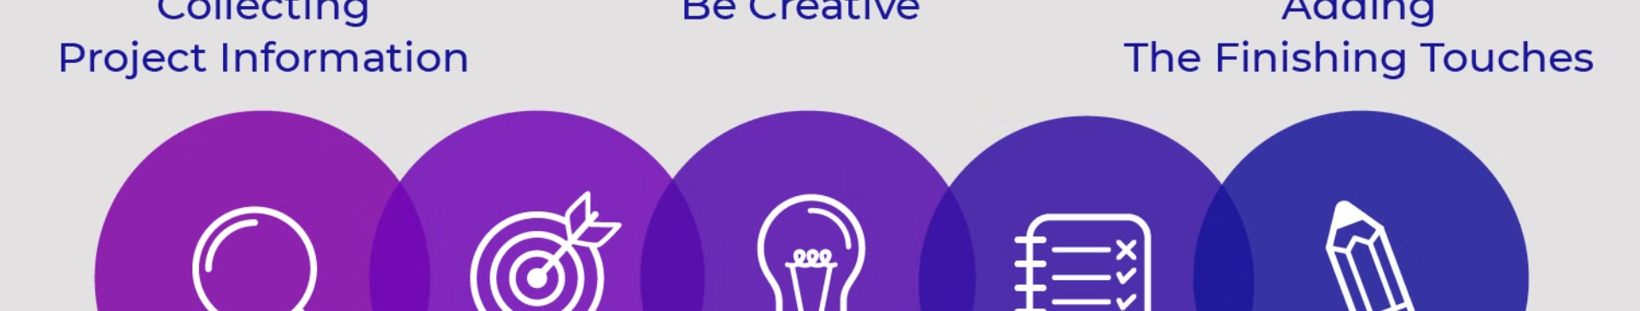
Why choose Web Designing
High Demand
Creativity Unleashed
Endless Possibilities
Web design is a rapidly growing field with a high demand for skilled professionals across a variety of industries.
Web design allows you to blend technical skills with creative expression, enabling you to bring unique digital experiences to life.
The web design landscape is constantly evolving, offering endless opportunities for innovation, adaptation, and professional growth.

Slide 9
.
Q & A
.
.

Slide 10

Thank You
Thank you for your time and attention. We hope this presentation has provided valuable insights into the world of web design and the opportunities available at TOPS Technologies. We appreciate your interest and look forward to discussing how we can help you achieve your goals.

